Slide 1
Artificial Neural Network from Scratch
Abhijeet Lodhiyal

Slide 2
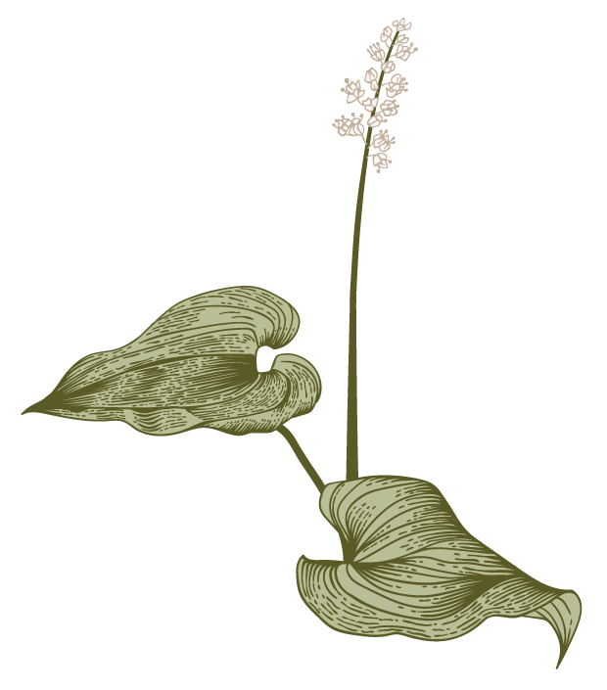

Agenda
ML
Introduction
Primary goals
Functions used
Summary

Slide 3
Introduction
An artificial neural network is used to mimic the human brain by creating a model that is similar to that of our brains . We can use an ANN for various purposes like face recognition, anomaly detection and various types of predictions .

Slide 4
Primary goals
To create an ANN which can predict handwritten digits with great accuracy.

Slide 5
Functions used
The activation function is the function that a neuron or node uses. Here I have used the sigmoid function for each layer.
The output layer also uses a SoftMax function which is used to normalize the sum of the results to 1.
The predict output function is used to implement forward propagation. It is done by multiplying the weights and the biases with the output of the previous layer.
The backpropagation function is used to adjust the weights and biases such that the model predict the correct value .

Slide 6
np.outer function is used to multiply every value of 1 vector to every other value of the next vector.
eg. weight_op_update = learning_rate * np.outer(change_op, hl_output2)
Here, every value of change_op is multiplied with every value of hl_output2 to form a two-dimensional vector.
hl_output , hl_output2 are inputs to the next layer.
We update the whole matrix for a single example using np.outer .

Slide 7
Summary
The artificial neural network which we built gave us an accuracy of 92.95 percent which is a decent accuracy for a model built from scratch.

Slide 8
Thank you
Abhijeet Lodhiyal
abhijeetlodhiyal@gmail.com

